Slide 1

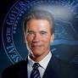
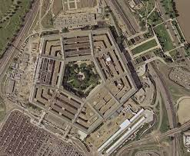
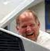
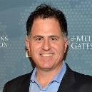
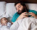
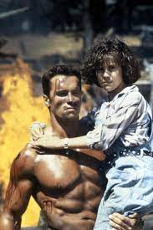
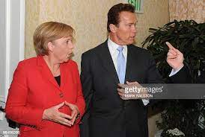
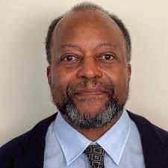
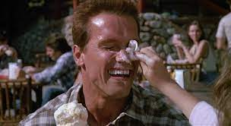
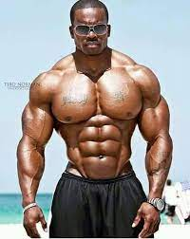
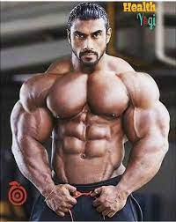
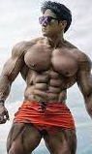
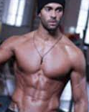
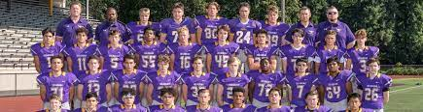
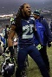
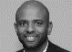
FBI
partner
development
development
v2.FBI:KIDNAPPING
!Phil(kim).ATOMLCLOCK(CPVA§187.PREA !sub-summed:family)
I am sittin there with my daughter in my lazy boy and then… these poepl?
Installin ibm tiovli.
“Whoel Football Team”
!CPVA=§187.PREA
ONSITE
2015 May
2015 August
Workday.apple
Apple.tango
“China”
G.GOD.ELEVATOR
Otis, Morgan
HOCME:DOG:HOOVER
2015 January
“Black”
Apple.phone.actale.uebereats
“India”
“France “
Apple.atart.tango
OFFSITE
Police Sirens: 8:10AM
HAMILTION-2: why can we be friend video
HAEMILTION-1: hobo firecans music video; my homework then rape

Slide 2


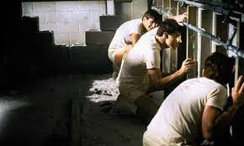
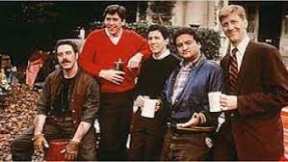
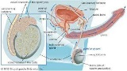
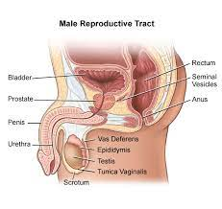
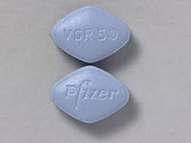
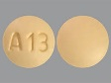
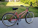

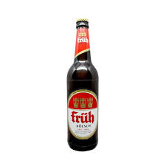
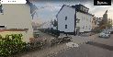
FBI
partner
development
development
+17
2005 PENTAGON.emea.deere.emoploye.Jeff.Janke Dartmotu “Animla house?”
animal hosue person raped on log in varsity coat: google
1988 “Animal House §Rape”
x
200? x/y cognitive; ?
!raik
Full flight of stairs
Gorbachev(Dell.quest.employe.uwe.heitkamp)
!CIA.marx((!BundesPolizei, !BuidnesIntelligence)
Gas
Rudolf-Diesel-Strasse
John(1)
Phil(kim).HOMCIE:BUNNY:”hase”
Kommando “Bimberle”
1995/6
St. Francis
St. Thomas(thoasm-is-dieter:nees)
HOMCE:ANNES

Slide 3

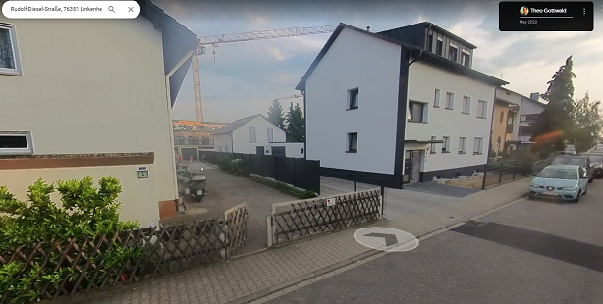
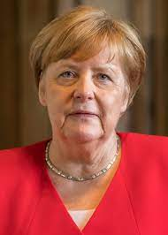

FBI
partner
development
development
-1 day
Sunclock paiting
Cooking fecal in cooking pan(scent)
Phil.kim:HOMIE:BUNNY(hase)
0.1 x/y HOMIEC:great_great_grandfather:phil
!HOMCE:ur_ur_opi
St. Peter.DomKoles.phl.kim(von dem bushe)
IPX
ohren schmalz koelsch film 1986
sie nannten ihn hase, am naehcet morgen
1995/6
St. Francis
St. Thomas(thoasm-is-dieter:nees)
HOMCE:ANNES

Slide 4
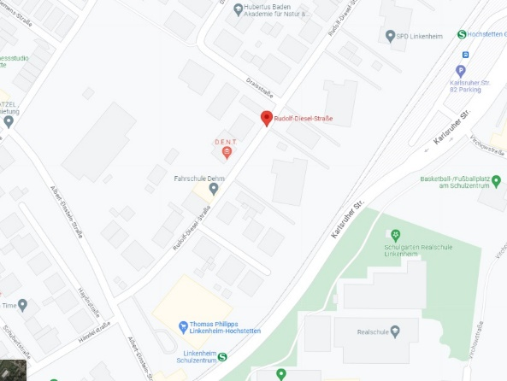
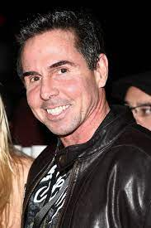
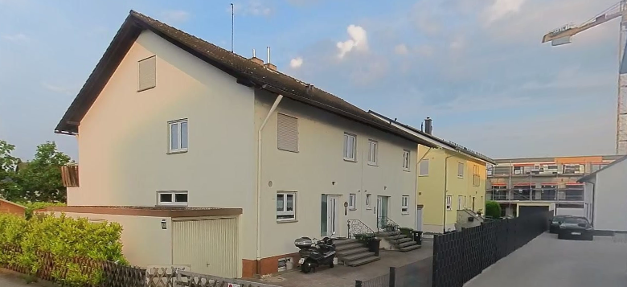


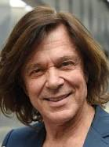


FBI
partner
development
development
N/E/W/S Never Eat Screded Wheet
Petogn.Teach.Paul.Brack.Mary.Renoldys
!ENGLISH CHANNEL
Tivoli Tems roth.ibm.dmiler.accenteurappel.touch.greenstamps
Angle shopping only,Franz Joepsh VIRIANG.MARY.marx,Etc; whole town
PREA
JOEL
!§Theft marlboro
F
WWI.marx(kaiserkaffee;market)
HW1
NORTH
Visa North
Apple North
Nokia North
KING.NORWAY Noth
“Petersson South”
Build house on my Markieting
ATOMCLOICK
(MLK(nonPoliceMarkign).nonPoliceTV)
HAMILTON:HOMCIDIE:JESUS:EU.1/4.marx
Frauenhoffer Institute(MP4)
ATOMBOMB(HAHN,DSLR.!HOMIC:HCANRLEO german hardcore)
St. Peter-Ording (NORD/NORTH)
NAME CHANGE(free visa jesus)
P-I-Z-Z-A

Slide 5
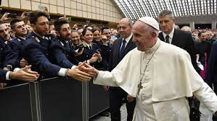

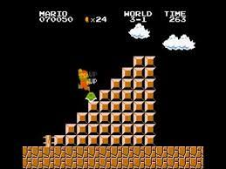


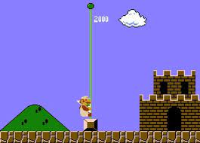
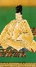
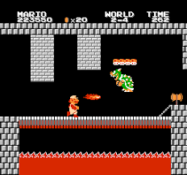
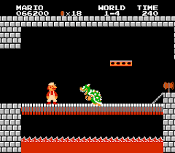
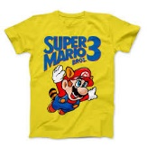
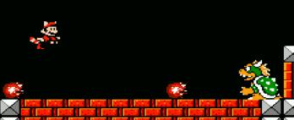
FBI
partner
development
development
N/E/W/S 1945/1990
x/y WWI.WW2.CHECKPOIN CHALRIE
Unlimited Lives
3-2
!CALTHOLIC
WWI Super Mario ->boswer
2-4
Dev-Eng.Avg: Carlos
WWI.marx
Latin/Latino/Meican/Mexico
“Bowser”
1-4
Super: Mario

Slide 6



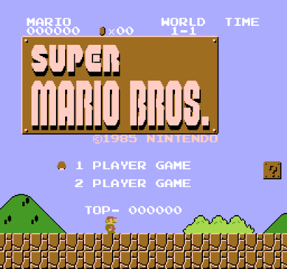

FBI
partner
development
development
N/E/W/S 1945/1990
x/y WWI.WW2.CHECKPOIN CHALRIE
Unlimited Lives
3-2
!CALTHOLIC
WWI Super Mario ->boswer
2-4
Dev-Eng.Avg: Carlos
WWI.marx
Latin/Latino/Meican/Mexico
!MATEO(2 Player )
“Bowser”
1-4
Super: Mario

Slide 7


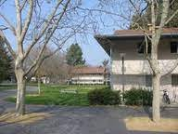
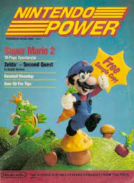

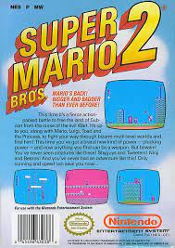
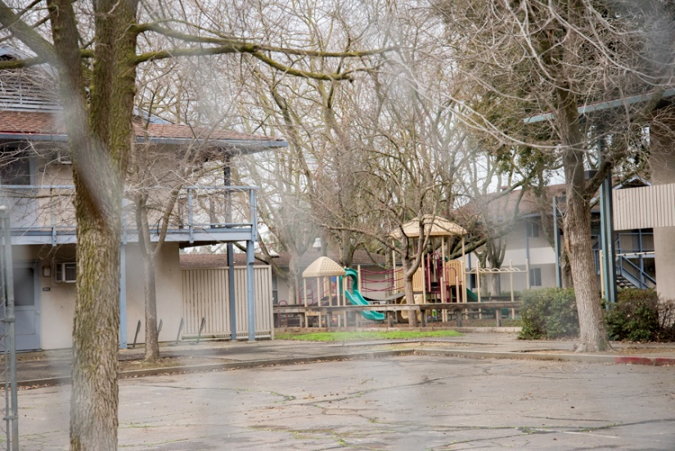


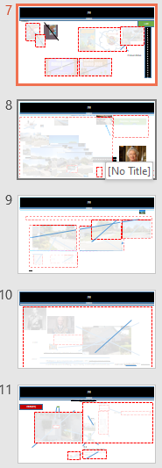
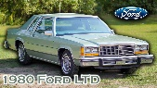
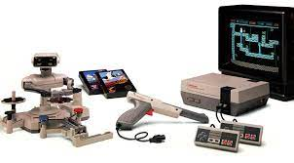
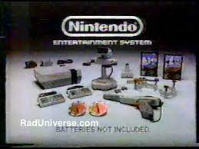
FBI
partner
development
development
1988/9
JOEL(8)
J-10
(left) Phil(kim) PREAK2010-2017 bay area backroads; to fired Prison:Wards
(right) 1988 water park
Apple.division.marx(haellsangles SAC-SF
NAVY.SAYLOR
F
F
waterpark
F
F
F
F
wooz
2 Hours Drive
F
F
Borrowed
Marlin Ave
F

Slide 8
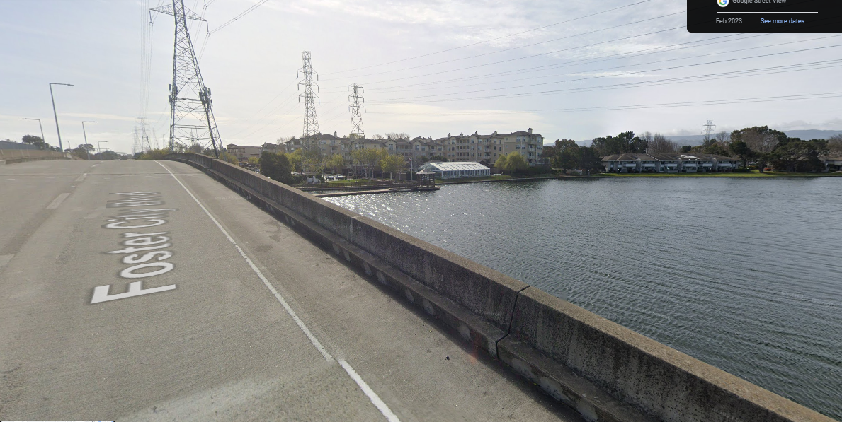
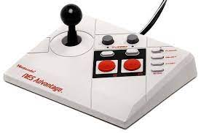



















FBI
partner
development
development
“Wake Up We made it”
1994 CHECKPONIET CHALRI
San Francicsco
F
F
Bungee jumping
Mohter: if other person jumps off bridn do you jump off bridge?
1) No 2) ? Sieltn: that brigde? 3) 10y lthat bugge jumping that bridge?
Franciso; Fracesco
Borrowed contoller
phil(kim): move ouste brad.avg.bridge
x
2 Housr Drive HW-80 Sacramento – San Francicsco
0.1 Nana’s house
Fraciscan
0.1
F
Minnsoaat phil(kim).MATEO
F
F
F
HOMICIE:BORIS: CHECKPOIN CHAEIL(kdew, grebe employer HOCMP:ETER, HOMCE:BORIS:IPX:HOCMIEFESTBECK caping, !fred )
They wetn to minesotta
Herr Greber

Slide 9








FBI
partner
development
development
FBI:WMD
x/y move
!ATOMCLOCIK(INT.ENT.PETERSSON.St.Peter:HOMICIDE:PETER
0.1 phil(kim): hoas on the water?
FBI:WAR CREIMS GENOCIDE Slide[] !§Agg Assult, §Public Disbance
Create Slide Desk(incidents), !000
1986 Demember
Out of Store: Bushes Scent
In Store: Platic Scent
0.1 IPX HOMICDE:LUX walking to park HOMCE:LUX:COINTONW:HOMCE:LUX:HOUSE:HOMICE:LUX:PARK
Bejamin

Slide 10




FBI
partner
development
development
F
King of Worms
Dutches of Solms - Irense Solms
Marlon zur Niederwegs
1988
Johnson, Bradely: Mattie has worms
2017
Phil(kim): katy Livermore, Califonria IPX garbage can !worms
nonPOlicHuamnTraffking. w/o famly nonPocliProstatuionLaw
G.GOD.VIRGINA.JP/JB Otis Morgan
IMPORT prostetues

Slide 11







FBI
partner
development
development
“Wake Up We made it”
San Francicsco
INT.IPX
JOHN(65)
F
666
Sign of the devil
green
F
F
INT.IPX 66 Alios-Degler-Strasse
F
F
Pacific
“!Wind”
F
F
0.1
PanAmerica(Pacific)
Tawainse Military Jet
“Wind”
1981/2 WATER
F
F

Slide 12




















FBI
partner
development
development
Mother: Do you want to go the wooz? On the weekend? $5Airwalk, Nike Air $30
ATOMBOMB SCHOOL(pre.WW1.Verdun France,30Y war)
F
2000/1 sociea studies teacher
0 US.LEGISLATON
1991
x/y walk out
manic
Science Book
“That is Dryed Ice”
sieltn 0.001 Los Angela Visit Father
F
Katy boeh/madnna
Jason/tyson
NAVY.“tatto”.IPX.WIFE.”tatoo”
Soccer kick leg left middle(back)
IPX

Slide 13









FBI
partner
development
development
QUEEN.!HOMCIDE:NANA.lingusits(mirror newpaper)
ATOMCLOCI(CPVA.NEWPAPER)
FORT MYERS IMPORT Police MARK ( newpaper devliver front door regus)
FORT WORTH IMPROT Pocle !JYLL (newpaper delivery fron door LIBRARY)
Dell(quest.client.weltbile)
G.GOD.Cherytree.damiler.fiat.anglea.bild
!HOMICIDE:ur_ur_omi
Remaired American 2003
Delivered newpaper to Girlfirnd grandfather 1994
F
Ryan’s Bicyels §Theft
Phil(kim).green ford[] cracked nuts vistiing
WWI.6c.andreas.kaiser.VIRIGNA.MARY
sung
!mini playback
F
Gorbache(nutcracker protection)
2014 CPVA mili.vanili FBI:WMD for Office Shooter anmimals IPX.INTENET 6c.WWI.marx(Kaiser)

Slide 14







FBI
partner
development
development
“Plants” 2023.25Y ibm-dns:season.com
St. Nick
St. Nick
Favorite Plant: Nanas house near shoreline in Foster City
CACTUS
plant types near oceanside
Jade Plant
Sea Purse Lane
Default: Golf
Minnesota Pasture: Description by Mother

Slide 15
FBI
partner
development
development
!white.gheoh(sap).Cupertoin.CPVA.CHECKPON CHARLIE HOCME:NANA(anagle merkel)
w/sam aqusiton al zollar picture; piano illstation tibero sf views
IPX VIRGINAI
F
foster city califron japanase archtiecutre
foster city califron japanase archtiecutre
F
x/y stanfore.gentece.yang
IPX cook HOMCIP:NANA
gary
F
Tiberour califron japanase archtiecutre

Slide 16














FBI
partner
development
development
1988/9
!ROBERT
HOMCEI:TRANVESTIE
F
PENTAGON.WW2.PAULBARACK.PX.!HOMICIDE:JESUS
1994 ♥LACE Complet Set Box
EVIDENCE
F
F
Ibm ONSITE !OFFE eddi.elk.grove
Eddi
F
robert
F
Back office, yang kora mico store
Front office baseball card store
Daveid worth, green, irish
Come to my house I will show you my baseball cards( micostore)
x
white empty box base ball card 32 incens

Slide 17












FBI
partner
development
development
1986/7
G.GOD.HOIMCE:DOG.HOOVER.SAM JFK(Presidnet Obaman, Sam Palmesano)
F
F
Danger Bob
Stanford.Genetech
F
Gov. Schwazzeger(McCARTHY) twins
EXPORT
IMPORT Wells Fargo, Mathew
St. Rita.Dublin Prison.HQ Ross, Califonra.apple.touch.greenstamps.iwatch
TORT-1: DeYoung Musuem(alkada)
IPX Gov.(Newsom/Schwarzenegger)
F
F
F
F
KING.QUEEEN.phil(kim).MINESOTA
Meadows
Indoor Soccer / Outdoor Soccer
IMPORT HOCMI:JEUSE(caleb)
Vp Visa(italien)
Wells Fargo, Mattew
Tim ?, Tiberon
Shane ?, Busines Consuation Star
QA Bennete, Andrew
IMPROT !AVABILITY QA beenteon.stevenaie.sabery
IMPROT stouch.greenstame.deveil.davud.?
!speedy gonzales
+17
0.1 avg.
F
F
03:00

Slide 18







FBI
partner
development
development
April / May 1987
Marlin Ave
Paul.St. Martin: “Do you remember Satuday Morning Cartoons”

Slide 19







FBI
partner
development
development
April / May 1987
Marlin Ave
!phil(kim)
PacifiAmerican(x/y)
1MLK(sin) 14 1995
Asusem: data 2017-2019
0.001 CPCA SF->FORT MYEERS.PAUL
1st grade twins boy/girl Koreans(!sung)
CPVA
F
Paul.St. Martin: “Do you remember Satuday Morning Cartoons”

